Slide 1
Forest Landscape Restoration A holistic approach to realizing SDGs and Uganda’s Green growth Development Strategy
2nd Uganda Waste, Water and Environment Convention 2019
By Cotilda Nakyeyune, IUCN Uganda

Slide 2
Content
Linkage between Forests and Water
Defining Forest Landscape Restoration
Why the Forest Landscape approach is crucial
IUCN’s contribution

Slide 3
Linkage between Forests and Water
Vegetation cover, of which forests from a major part, regulate on-surface water flow, and improve water infiltration for better recharge of aquifers.
Forests also regulate micro-climate humidity through evaporation and transpiration from the large surface area of canopy leaves.

Slide 4
Linkage between Forests and Water
A significant portion of riparian vegetation are trees, which contribute to the health of water ways
Unfortunately, Uganda’s forest cover is fast dwindling in spite of the many efforts in planting trees and improving forest management.
1990, Uganda had 4, 880, 484 Hectares of land covered with Forest (24% of total land area). By 2015, this had reduced to 1, 829,779 Hectares (a mere 9% of total land area).

Slide 5
Defining Forest Landscape Restoration
Forest landscape restoration (FLR) is the ongoing process of regaining ecological functionality and enhancing human well-being across deforested or degraded forest landscapes.
Key elements include; Landscape approach, restoring functionality, Producing multiple benefits, stakeholder involvement, wide range of restoration options
Uganda pledged to restore 2.5 million deforested and degraded land by 2020 (under the Bonn challenge).
NATURAL FOREST
RIVER KAPTOKWOI
NATURAL FOREST
CROP LAND
PLANTATION FOREST
GRAZING LAND
SETTLEMENTS

Slide 6
Why the Forest Landscape approach is crucial
The landscape approach to management of forest resources creates a paradigm shift in planning and management of forest resources. This is realized through;
Taking into account the entire landscape in which forests resources are found, as well as the competing interests from a range of stakeholders, to come up with a feasible and shared management strategy.

Slide 7
Why the Forest Landscape approach is crucial
Challenging the current sectoral approach and practice to forest management, by bringing on board all key stakeholders (e.g. politicians, adjacent communities, cultural institutions, private forest owners, tourism agencies etc.), beyond the official traditional forest custodians like NFA, UWA and the District Forestry services.
Planning and managing forest ecosystems and also the other key interdependent or connected ecosystems as a single unit. These could be; wild life corridors, rivers and wetlands which originate from or traverse forests, or adjacent cropping land.

Slide 8
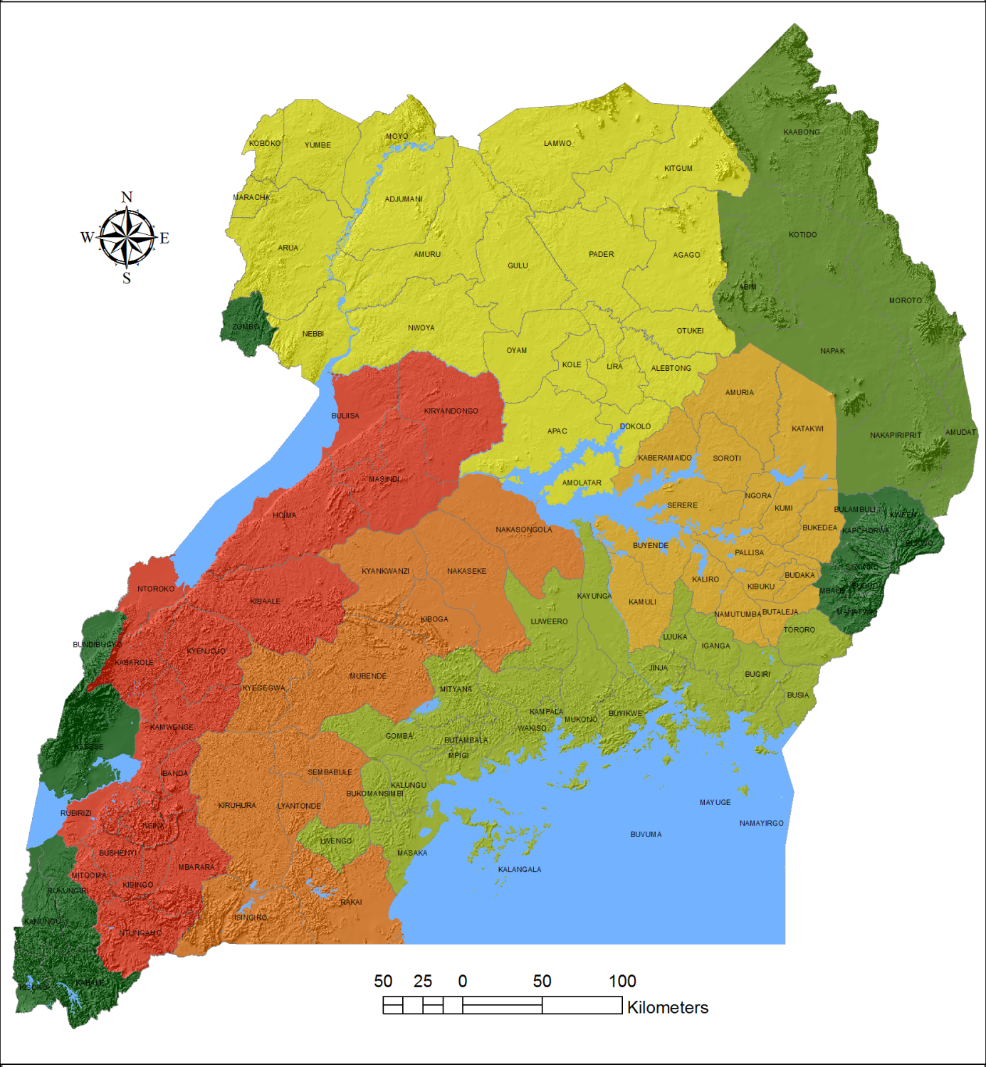
IUCN’s contribution
Between 2014/15, IUCN together with the World Resources Institute supported the Ministry of Water and Environment (MWE) to undertake and assessment, which identified the available degraded and deforested land across the country.
A total of 8,079,622 Ha of restoration potential was identified.
The country was zoned into seven homogenous landscapes, and for each of these, a suite of restoration options was identified.

Slide 9
IUCN’s contribution
A further assessment of the economic and financial requirements for restoring the Karamoja and Northern Moist Zones was carried out in 2017/18. Karamoja would require UGX 36.1 million/ district/year in variable costs, and UGX 470.7 million/district in fixed costs (to create enabling conditions). Northern moist (25 districts then), would require UGX 55.8 million /district/year in variable costs, and UGX 1.4 billion/district in fixed costs.
In partnership with ICRAF, IUCN developed the Africa Tree Finder mobile application, which supports tree growing through site species matching for indigenous species.
In Partnership with Farm Radio international, IUCN developed an FLR interactive radio series. The interactive approach combines radio, mobile platforms and social media to improve coverage and outreach beyond what can be realized with conventional radio talk shows.

Slide 10
Conclusion
If fully embraced, Forest landscape Restoration would greatly slow down forest and land degradation, by addressing the interests of all key stakeholders.
Through the application of the landscape approach to managing forest resources, we can directly contribute to six SDGs (5, 6, 7, 13, 14, 15) and three SDGs indirectly (1, 2 & 3).
Forest Landscape Restoration is a great approach for realizing three of the five priority areas of the Green Growth Development Strategy at Landscape level. Namely; Sustainable Agric production and value chains, Natural capital management and development, and Energy for green growth.

Slide 11
Thanks for listening

