Slide 1
International Water Stewardship Programme Powerful solutions for water security
Water Security Action and Investment Plan (WSAIP)
2nd Uganda Waste, Water and Environment Convention 2019
IWaSP workshop, Kampala,
15 Jan 2019
Notes:
Introduce myself:
My names is Mathew Parr. I am a Brit, working for the Germans, married to a Dutch lady, living in Uganda
10 years trying to influence corporations and governments in Europe to change the way they did economics.
Who is GIZ? State owned public benefit corporation. Work in over 120 countries, over 20.000 staff worldwide with annual turnover of over €2.4bil dollars. One of the largest development organisation in world.

Slide 2
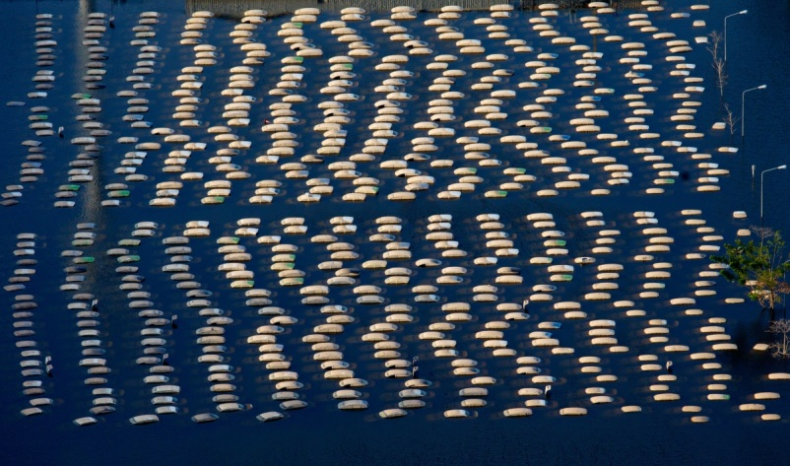
Why leaders put water high on the agenda? The Economics of Water
Water [security] crisis ranks among the Top 5 Global Risks identified by the World Economic Forum every year since 2012.
(World Economic Forum: Global Risks Report 2017)
“With water in short supply, there will be changes in what is produced, where it is produced, and the efficiency of production and water use. So, even local changes can be transmitted across the globe.”
„Improved water stewardship thus pays high economic dividends.”
(World Bank Group: High and Dry, 2016)
Notes:
Every year global leaders meet at a fancy retreat in place called Davos in Switzerland. Little more luxurious than Royal Suites. They don’t use bodas (that I know of).
Every year since 2012 water crisis has ranked in top 5
2011 - Honda factory Bangkok - $650 mil to restore and renovate. Affected 5 major Ips. Cost Thai economy $3bil.
“Unsustainable development pathways and governance failures have generated immense pressures on water resources, affecting its quality and availability, and in turn compromising its ability to generate social and economic benefits.” (World Water Development Assessment Report 2015, p.10

Slide 3
How have we responded? International Water Stewardship Program Countries and Key Partners
SAINT LUCIA
ZAMBIA
UGANDA
PAKISTAN
KENYA
GRENADA
t
HONDURAS
TANZANIA
COLOMBIA
PERU
SOUTH AFRICA
ETHIOPIA
IWASP Countries
Other GIZ Water
Stewardship Projects
IWaSP: 26,5m (2013-2019) from German and British Government
Over 25 partnerships > 100 Partners; Sectors: Food&Beverage, Oil&Gas, Mining, Textile, Agriculture, Insurance
Notes:
Snapshot of countries and partners.
Highlight range of sectors
Over 30 partnerships

Slide 4
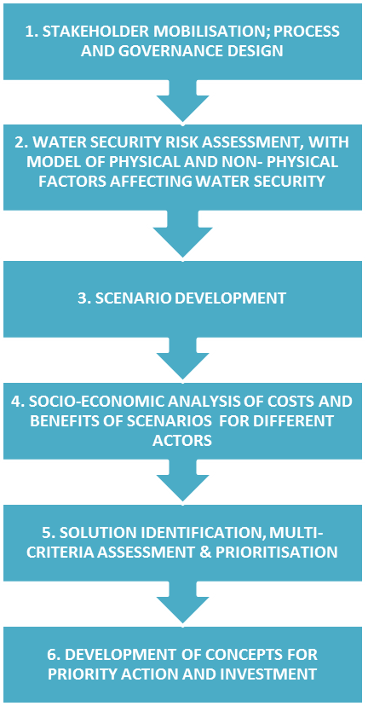
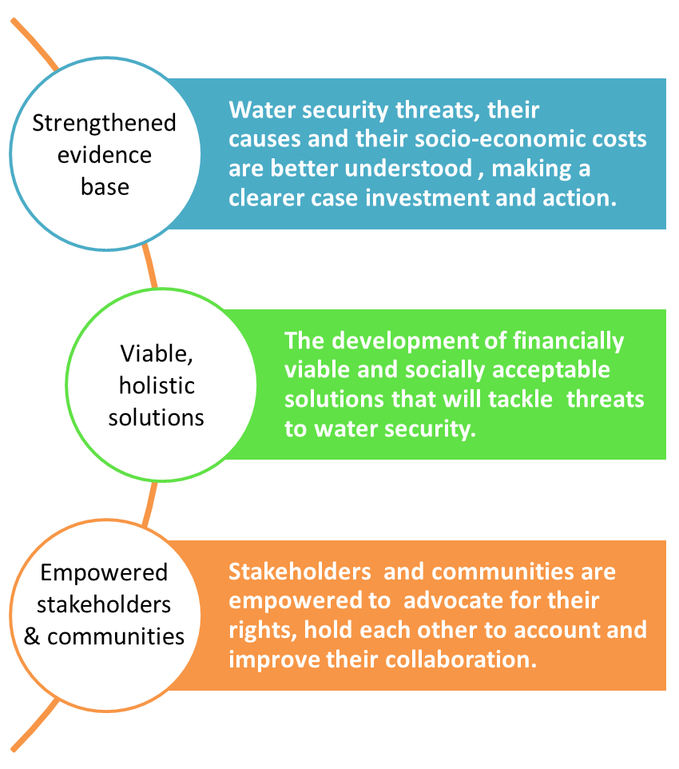
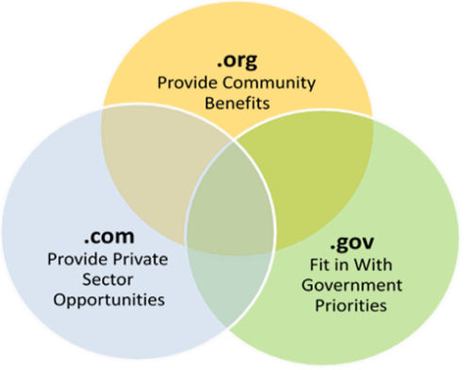
Conceptual Framework
How can we address the challenge in Greater Kampala?
CAPACITY BUILDING AND EMPOWEMENT
METHODOLOGY DEVELOPMENT, REFINEMENT AND DISSEMINATION
The WSAIP is an integrated water security action and investment plan in the Greater Kampala Metropolitan Area (GKMA) to support sustainable social and economic development.
WSAIP
Study
Engage
Stakes
TAs
Strong Evidence Base, X20 Prioritised Projects, and Empowered Stakeholders

Slide 5
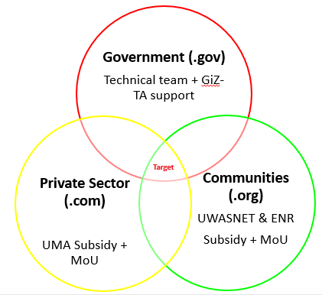
a. Stakeholder Engagement Plan
Stakeholders
Government
Private sector
Communities
Academia
Target (.gov.com.org)
Multi-stakeholder engagement platforms (e.g. Workshops)
Bilateral meetings
Collaboration in projects development
Seminars
Training Programme (TT)
Course + platform
Individual engagements e.g. Bilateral meetings and workshops
(common ground)
5

Slide 6
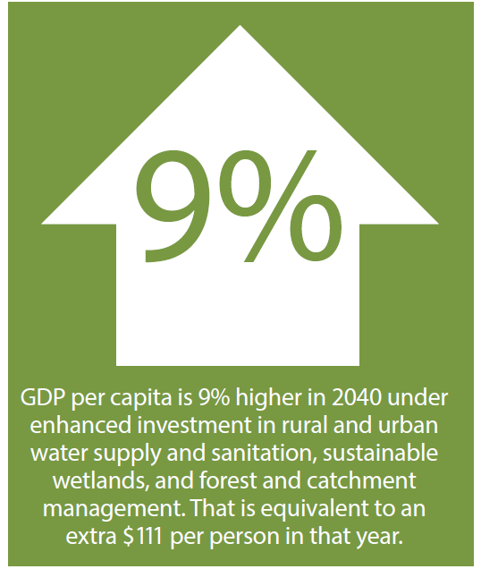
b. WSAIP Study & Risk Assessment
Situation analysis- hotspot identification & baseline for analysis
Economic analysis– Benefits assessment to build a case for investment. Formulation of alternative scenarios to estimate water security benefits
Based on The Contribution of Water Resource Development and Environmental Management to Uganda’s Economy” (Industrial Economics, 2016).
Ecosystems Health & Extent
Solid Waste
Stormwater Runoff
Effluent Treatment
BAU
Development
Degraded and poorly functioning ecosystems
Only half of waste generated collected
Increase the impervious land and limited drainage
Insufficient effluent management systems
Water Secure
Focused
Development
Restored and maintained ecosystems
95% waste generated collected
75% of region with adequate stormwater management
Comprehensive effluent management systems
Notes:
Situation analysis- A detailed situation analysis will be conducted under this assignment to inform the base case scenario for the economic analysis and to identify hotspots where shortlisted projects could ultimately be located.
Economic analysis - This analysis will be illustrative and will draw on a previous national level study of the economic benefits of water resource management. Results from the national study will be adapted to the GKMA area by scaling the national level results based on factors such as the current level of water security indicator achievement and the proportion of population and industry located in the GKMA compared to national figures.
The Contribution of Water Resource Development and Environmental Management to Uganda’s Economy” (Industrial Economics, 2016). The purpose of the benefits study is to analyze the economic benefits of water security in Kampala, which can be used to communicate the importance of projects that enhance water security to policy makers and donors.

Slide 7
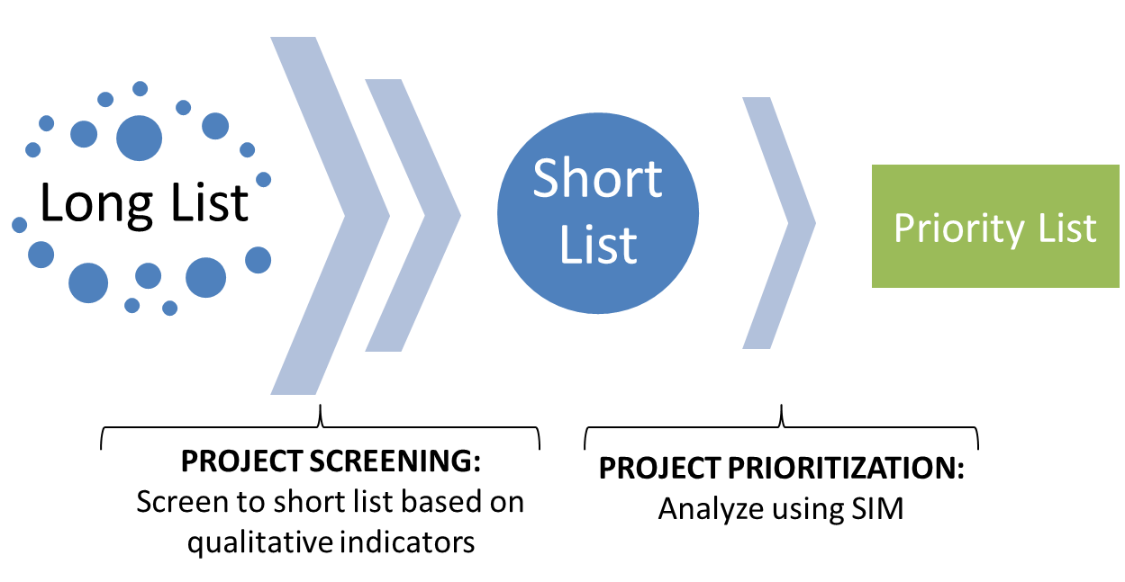
c. Scenario Development – Project Screening & Prioritization
Develop long list of project
Screening long list to short list using qualitative approach (multicriteria analysis).
Prioritisation projects on short list using quantitative approach

Slide 8
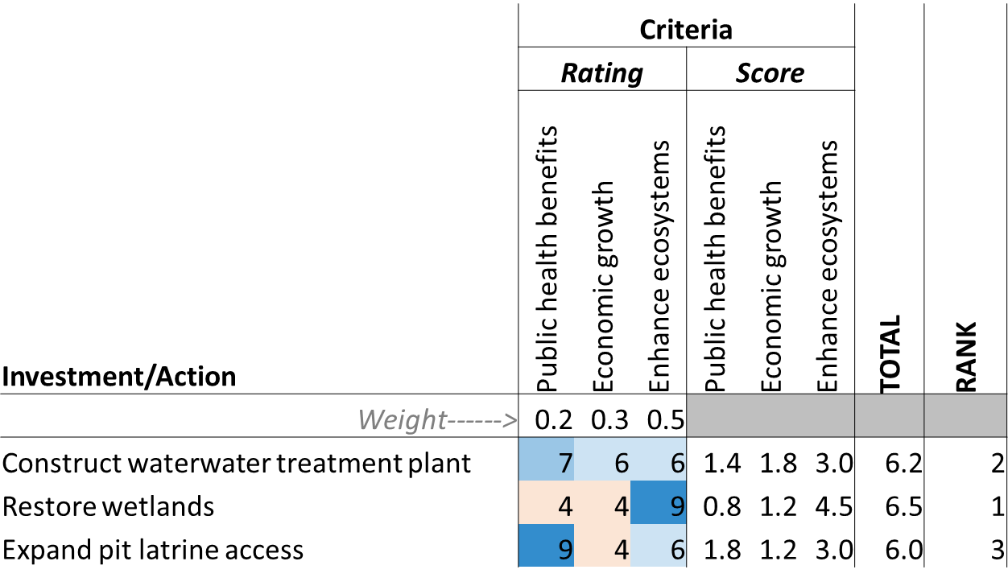
Scenario Development – Project screening (Stage I - Multicriteria Analysis)
Criteria used to evaluate the merits of these investments and actions
Weights measure the importance of the criteria
Ratings - the scores for each investment/action and criteria combination

Slide 9
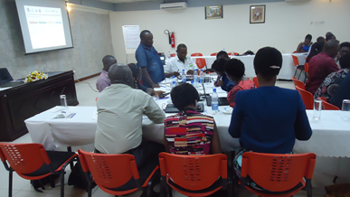
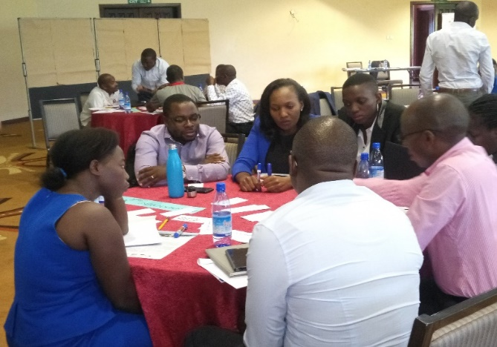
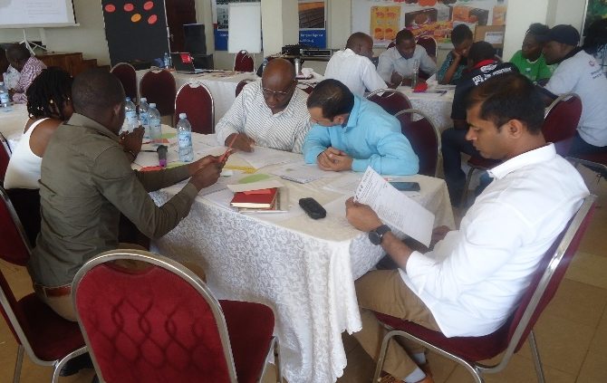
Criteria developed from Multi-Stakeholder Engagements
Environmental Quality Improvement
Socio- economic Benefits Provision
Public Health Improvement
Project Characteristics and Sustainability.
.Org
.Gov
.Com

Slide 10
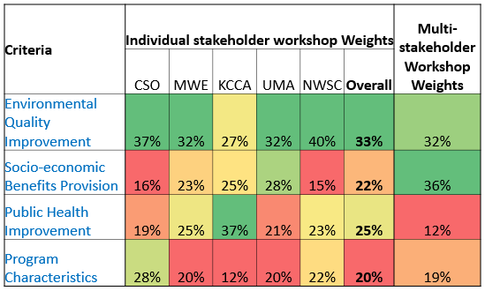
Weights developed from Multi-Stakeholder Engagements
.Org
.Gov
.Com

Slide 11
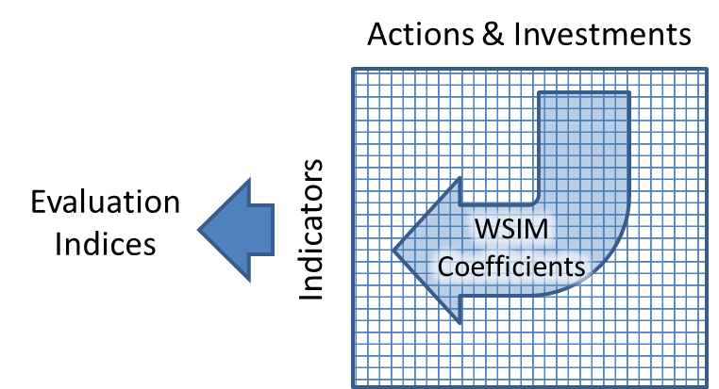
Scenario Development– Project Prioritisation
Stage II- Water Security Investment Model
Quantitatively compare short list projects based on indicator performance for example climate change resilience, economic growth, etc.

Slide 12
d. Ideation Road Map – Project Idea Action Areas
Land Use, Catchments and Ecosystems
Urban Planning & Land Use
Catchment Management
Storm Water & Flood Mgt Management
Water Suppy & Sanitation (Informal Settlements)
Feacal Sludge Management
Source Protection (Surface & Groundwater)
Solid Waste Management
Effluent Management
Water Supply & Sanitation (Formal Settlements)
Natural Resource Management (wetlands and green spaces).
Non Point Source Pollution
Community Empowerment
Industrial Pollution
Commercial & Residential Pollution
Regulations & Enforcement
Institutional Strengthening
Community Empowerment & Institutional Strengthening
Solid Waste Management (Informal Settlements)
Water Supply and Sanitation
Regulations & Enforcement
Solid Waste Management Services (3Rs)
Institutional Framework on Sanitation Management.
Community Empowerment & Institutional Strengthening.

Slide 13
Ideation Road Map – Developed Generic Investment Actions
Brainstorming and gathering of ideas (Workshops & Bilateral meetings)
Review of national and institutional strategic plans and programme documents
47 Multi-Stakeholder Projects 30th July 2019
Internal ideation Meetings- Lead Partners & Line agencies
(25 June to 10 July)
CSO Ideation workshop
(21st June 2019)
Technical Team Ideation workshop
(28 May 2019)
Private Sector Ideation workshop
(29th May & 04 July 2019)
Bi-lateral engagements local partners & Int'l partners (EU )
20 May to 15 July 2019
TA ideas (one on one follow-up and literature review - case studies elsewhere)
01 June to 25 July 2019

Slide 14
Ideation: Generic Multi-stakeholder Projects Conceived
Leveraging Public Private Partnerships for Fecal Sludge Management in Municipal Towns
Piloting industrial and business symbiosis to manage solid waste – mobile app
Greening Urban Open Spaces (Integrating landscaping into build environment)
Sustainable Urban Agriculture
Communal flood management initiative – upstream/downstream management
Lake front management
Scaling up water supply options for improved water access in informal settlements
Upgrade of Informal Settlements
Industrial/Enterprise Water Demand Management Programme

Slide 15
The Water Security Action and Investment Plan
Delivering Powerful Multi-stakeholder Investment Actions for A Water Secure Greater Kampala
END
Mathew Parr GIZ
Country Coordinator IWASP
mathew.parr@giz.de

